Slide 1
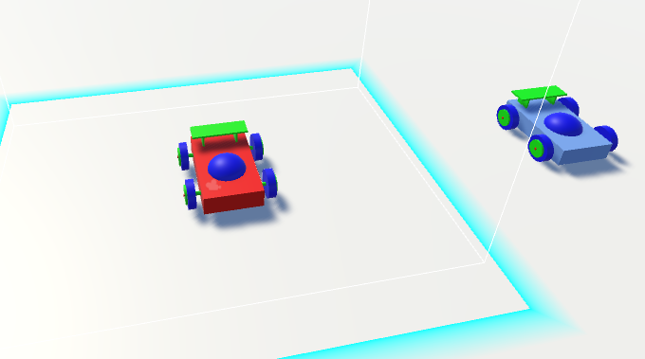
Mimic vr
A virtual reality simulation for robotics

Slide 2
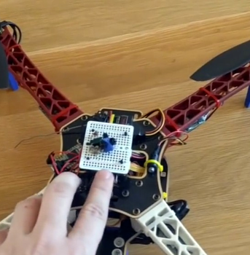
Background
HTC Vive Light house tracking
Open source Vive Tracker Technology
Drone and Robot actuation control through Vive
Tele-operated and Crime Scene Investigation Robots

Slide 3
Concept
Autonomous Agents utilizing VR tracking for navigation
Simulation and data recording from virtualized robot actuation
Response time and accuracy of path commands
How much can VR controlled robots Mimic Human movement?
Can a benchmark be used to measure movement accuracy?

Slide 4
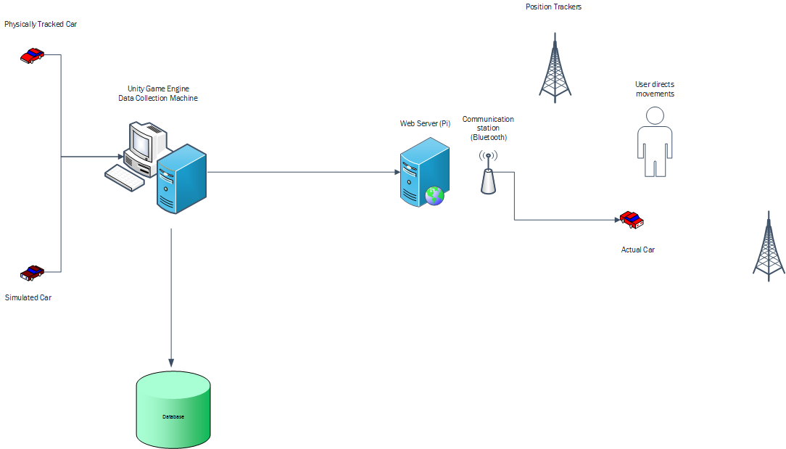
Architecture
The cars are split into two models:
The Unity Physics car
The VR tracked car
The server collects data on movements of each, and a Bluetooth module sends out movement commands to the VR tracked car.

Slide 5
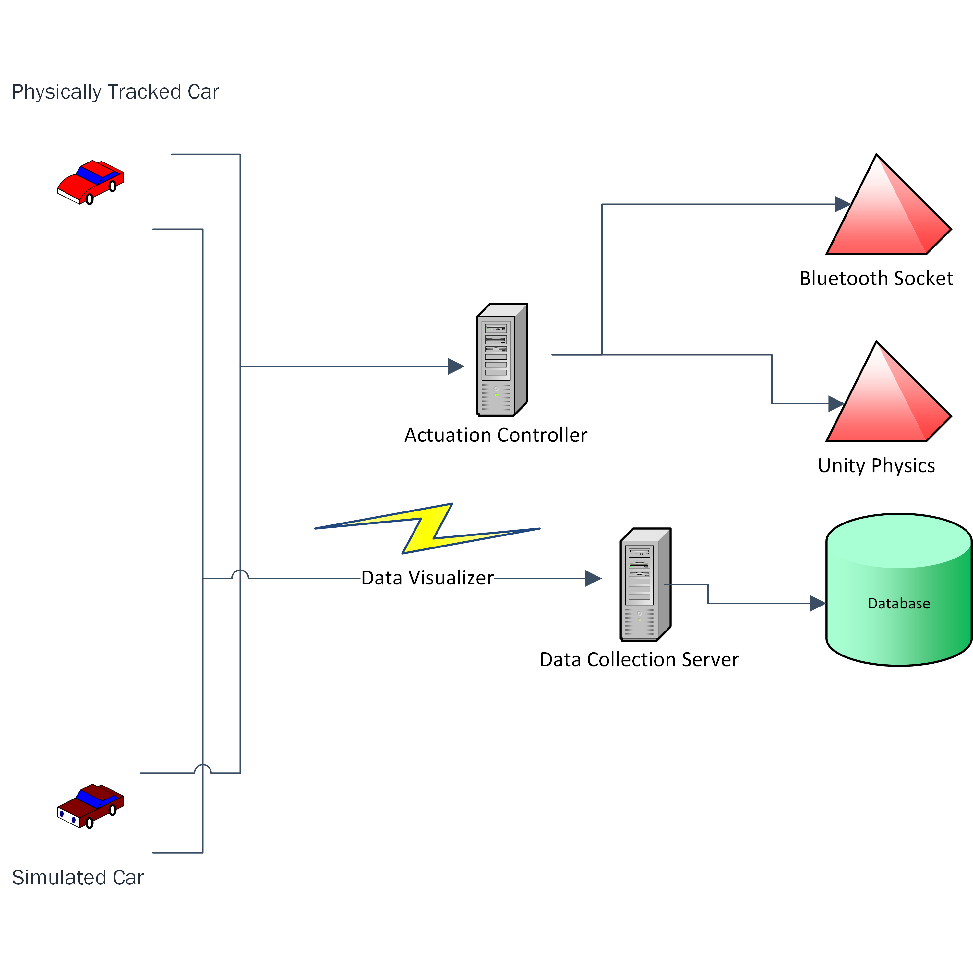
Network design
The network topology allows for simultaneous data collection. The actuation controller passes commands to both the Unity Physics robot and the Bluetooth socket while collecting data at the same time.

Slide 6
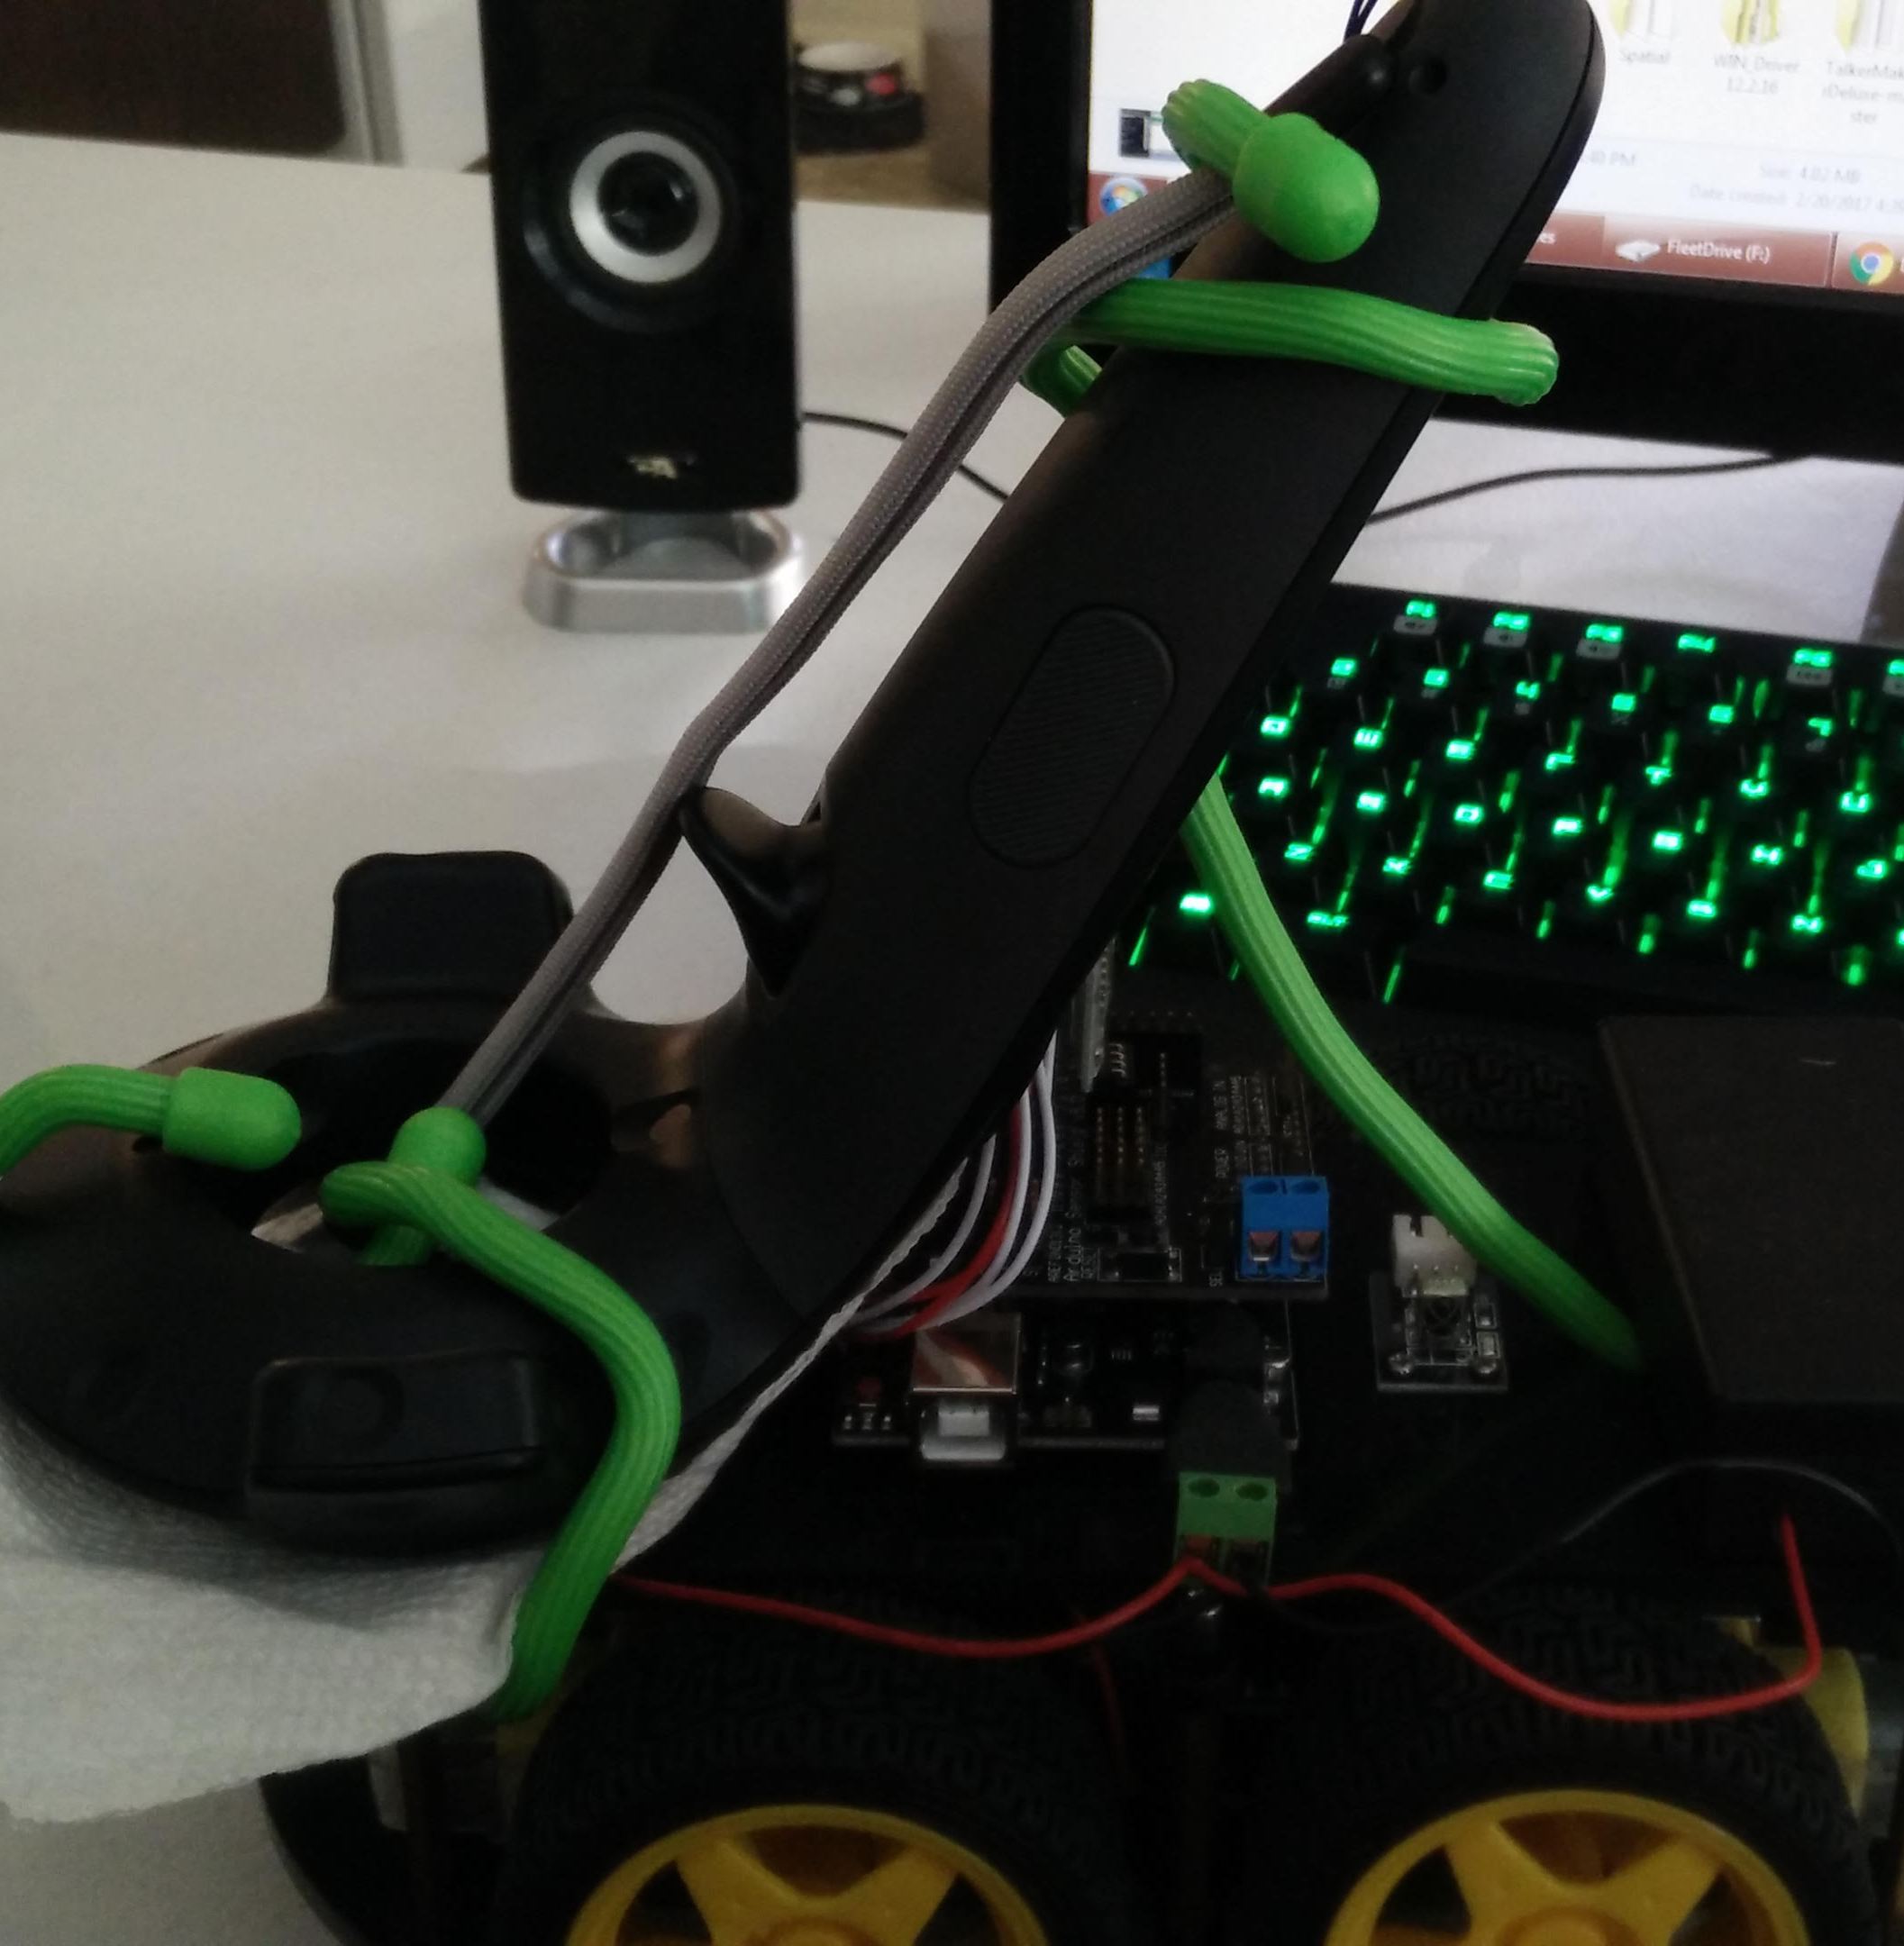
Robot v1.0
Uses hand controller tied onto the robot.

Slide 7
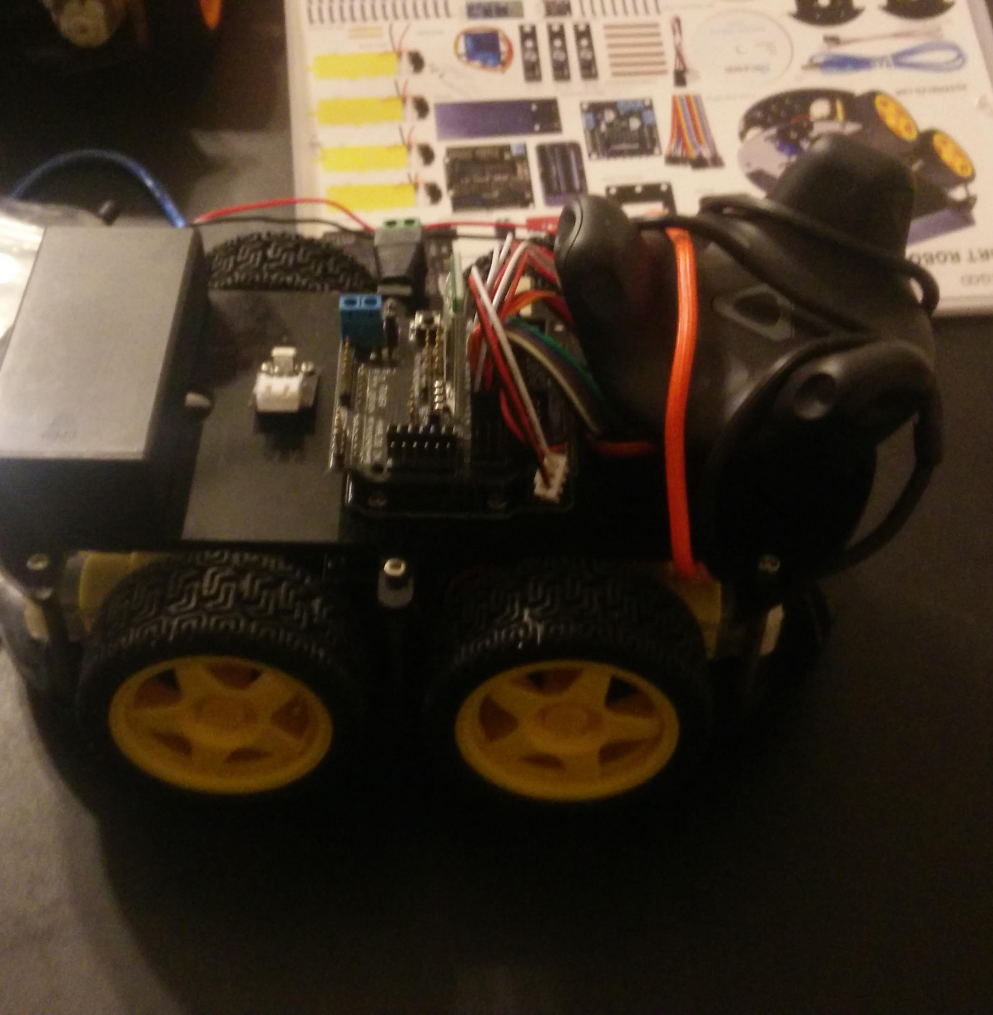
Robot v2.0
Uses Vive Tracker, lighter and more balanced for the robot and its movement. Allowed for usage of hand controllers to mark waypoints for navigation.

Slide 8
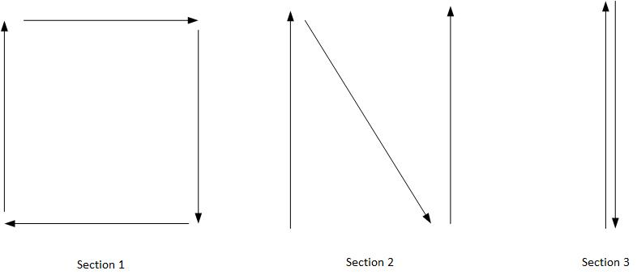
The Experiment
Test set 1 simulates the robot going from point A to point B.
Pairs of points are set up around the room and data is collected on its accuracy.
Test set 2 uses a continuous motion system, all points are stored in a waypoint queue.
Test set 3 utilizes path finding.

Slide 9
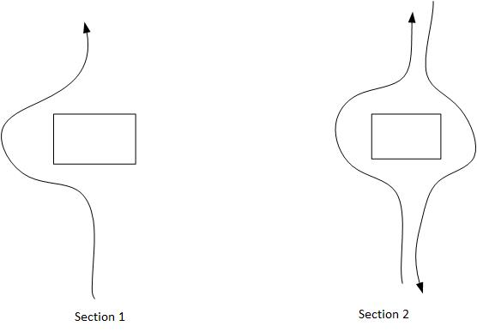
Path Finding p. 1
Uses collision avoidance detection to avoid obstacles using the VR simulation + A* path finding and automatically queueing waypoints.

Slide 10
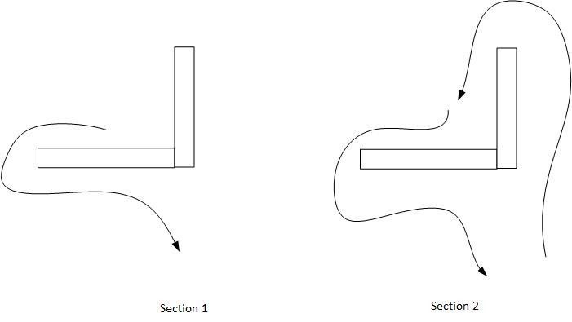
Path Finding p. 2
Tests the complex navigation system by moving around tight walls.

Slide 11
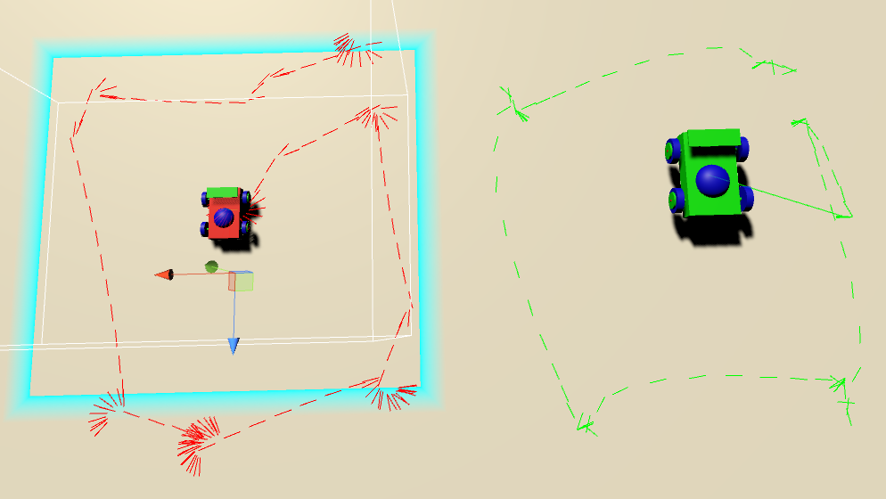
Results Overview
Visualization of Test set 1 – part 1

Slide 12
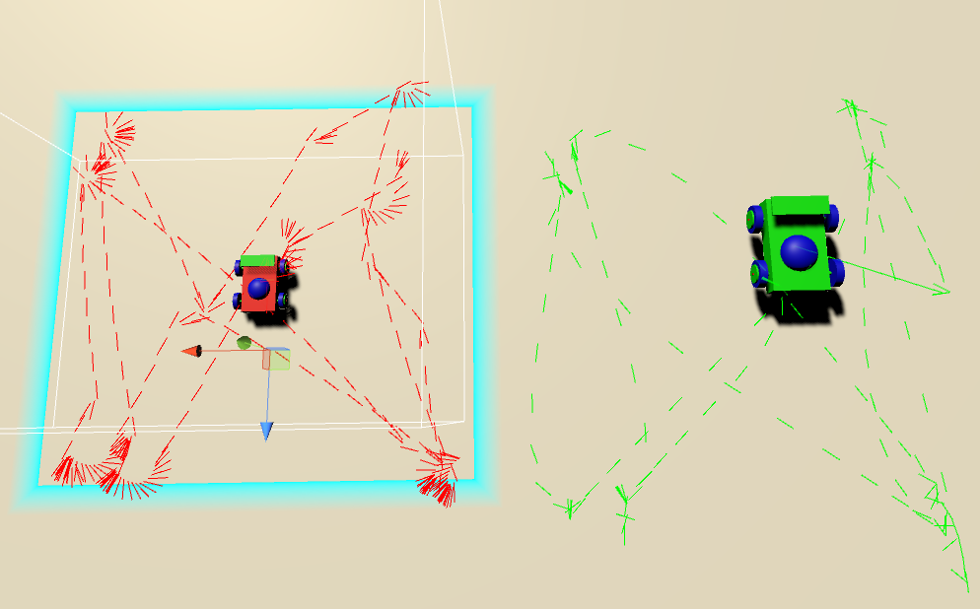
Test 1 - 2
The forward/backward N traversal.

Slide 13
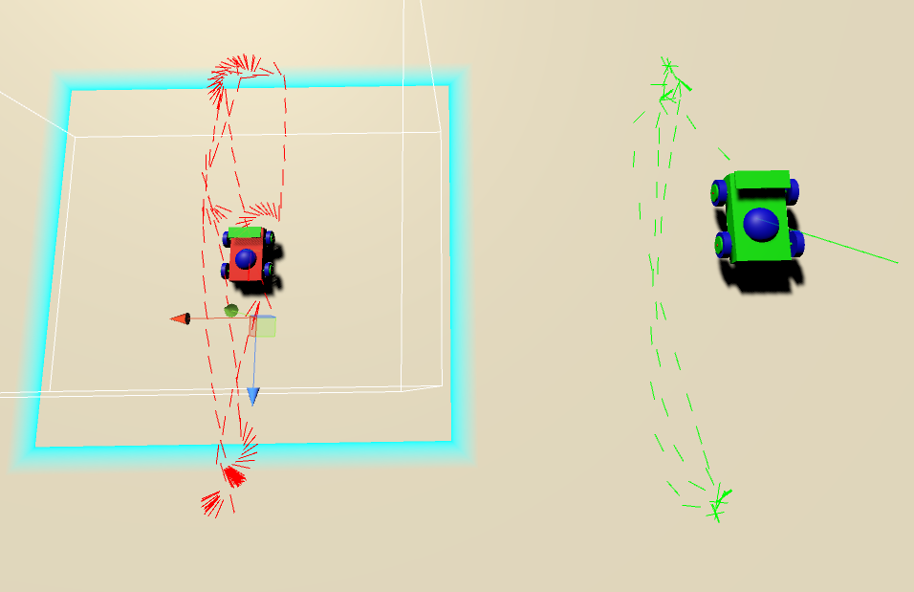
Test 1 - 3
The single file backward forward path.

Slide 14
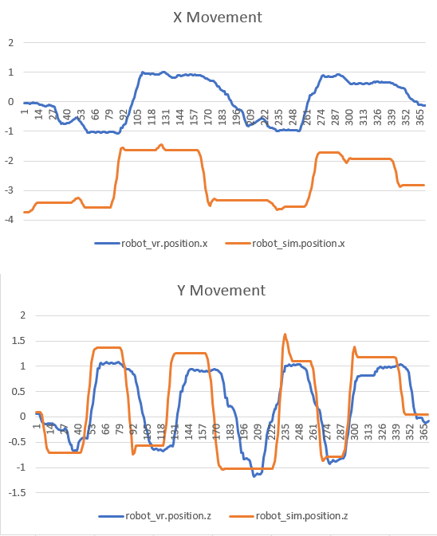
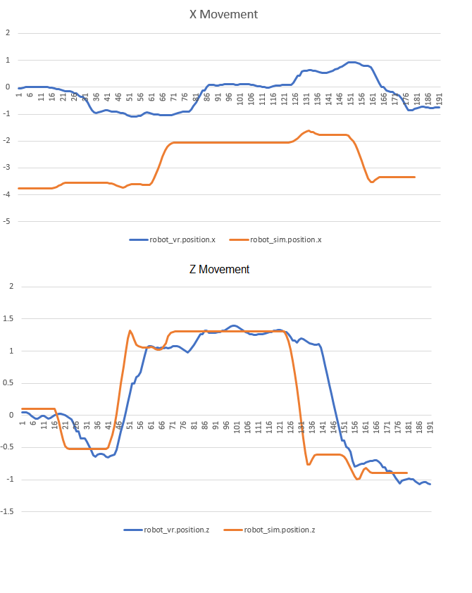
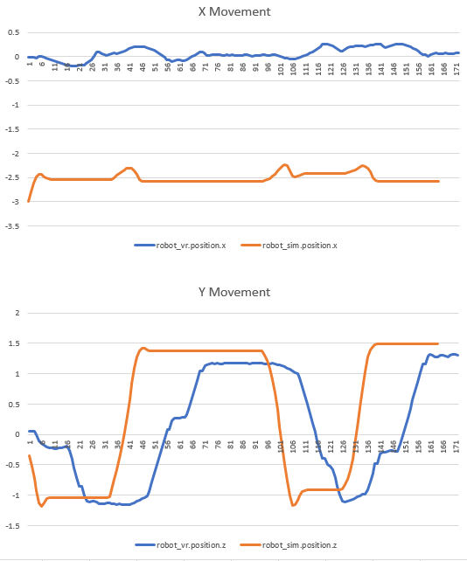
Test 1 – 1,2,3
Graphed coordinate traversal.

Slide 15
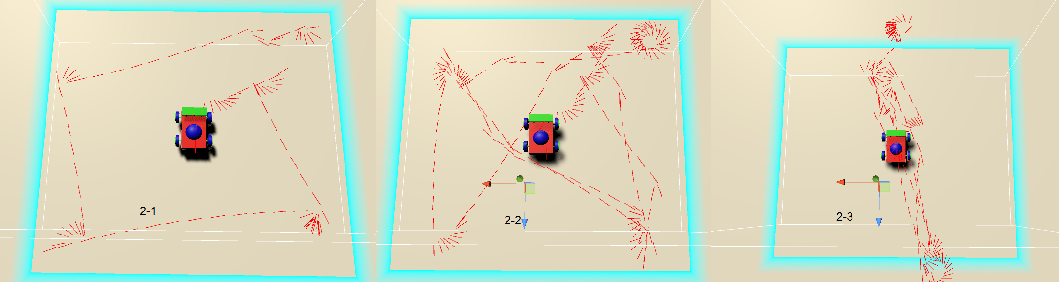
Test 2 – 1,2,3
Waypoint system

Slide 16
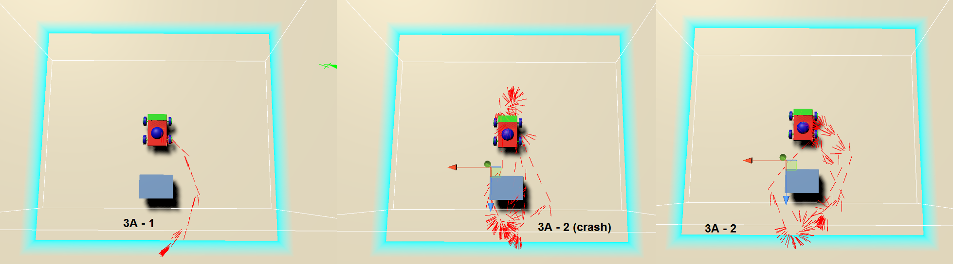
Test 3 – A 1,2
Path finding simple obstacle.

Slide 17
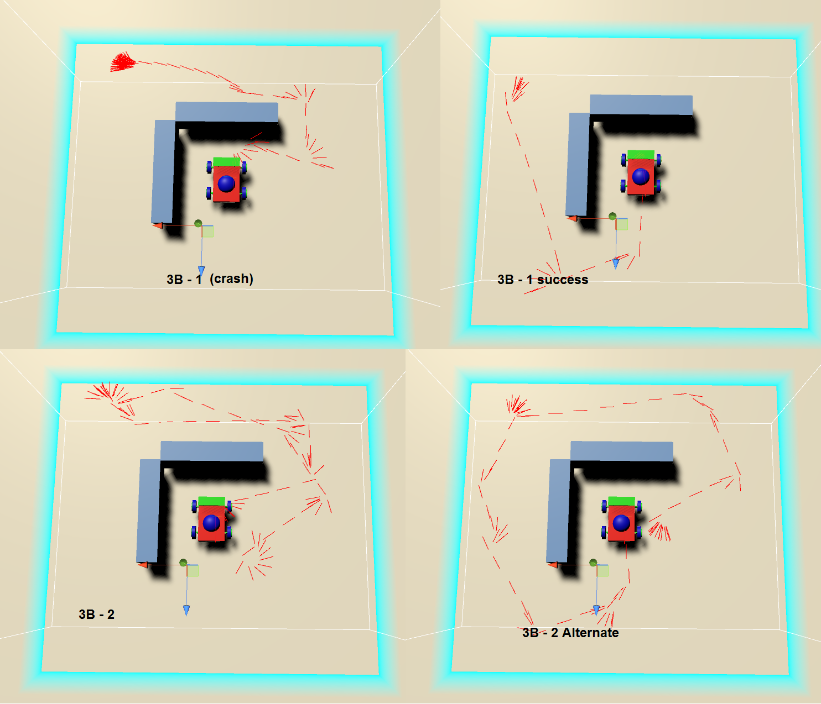
Test 3 – b 1,2
Path finding advanced obstacle avoidance.

Slide 18
Conclusion & Future Work
Robots responds and behave according to instructions
Robots successfully use in game AI logic to navigate
Need to improve the measurement system for environment setup in game
Could use 3D scanning technology developed for VR teleportation project in conjunction
Could improve to using more complex test cases
Use Inverse kinematics system for jointed robots, or robots utilizing all x,y,z coordinates.

Slide 19
Thank you
Questions?

